Slide 1
Electric Vehicles Revolutionizing Transportation
"Harnessing Sustainable Energy for a Greener Future"
Presented By:
1.Jeya krishnna.M—BNEC,EEE

Slide 2
OUTLINE
Problem Statement
Proposed System/Solution
System Development Approach
Algorithm & Deployment
Result
Conclusion
Future Scope
References

Slide 3
Problem Statement
The major reasons for the slow penetration of EVs are high purchase prices, limited driving range and longer charging time compared to conventional cars, as well as insuffi- cient charging infrastructure

Slide 4
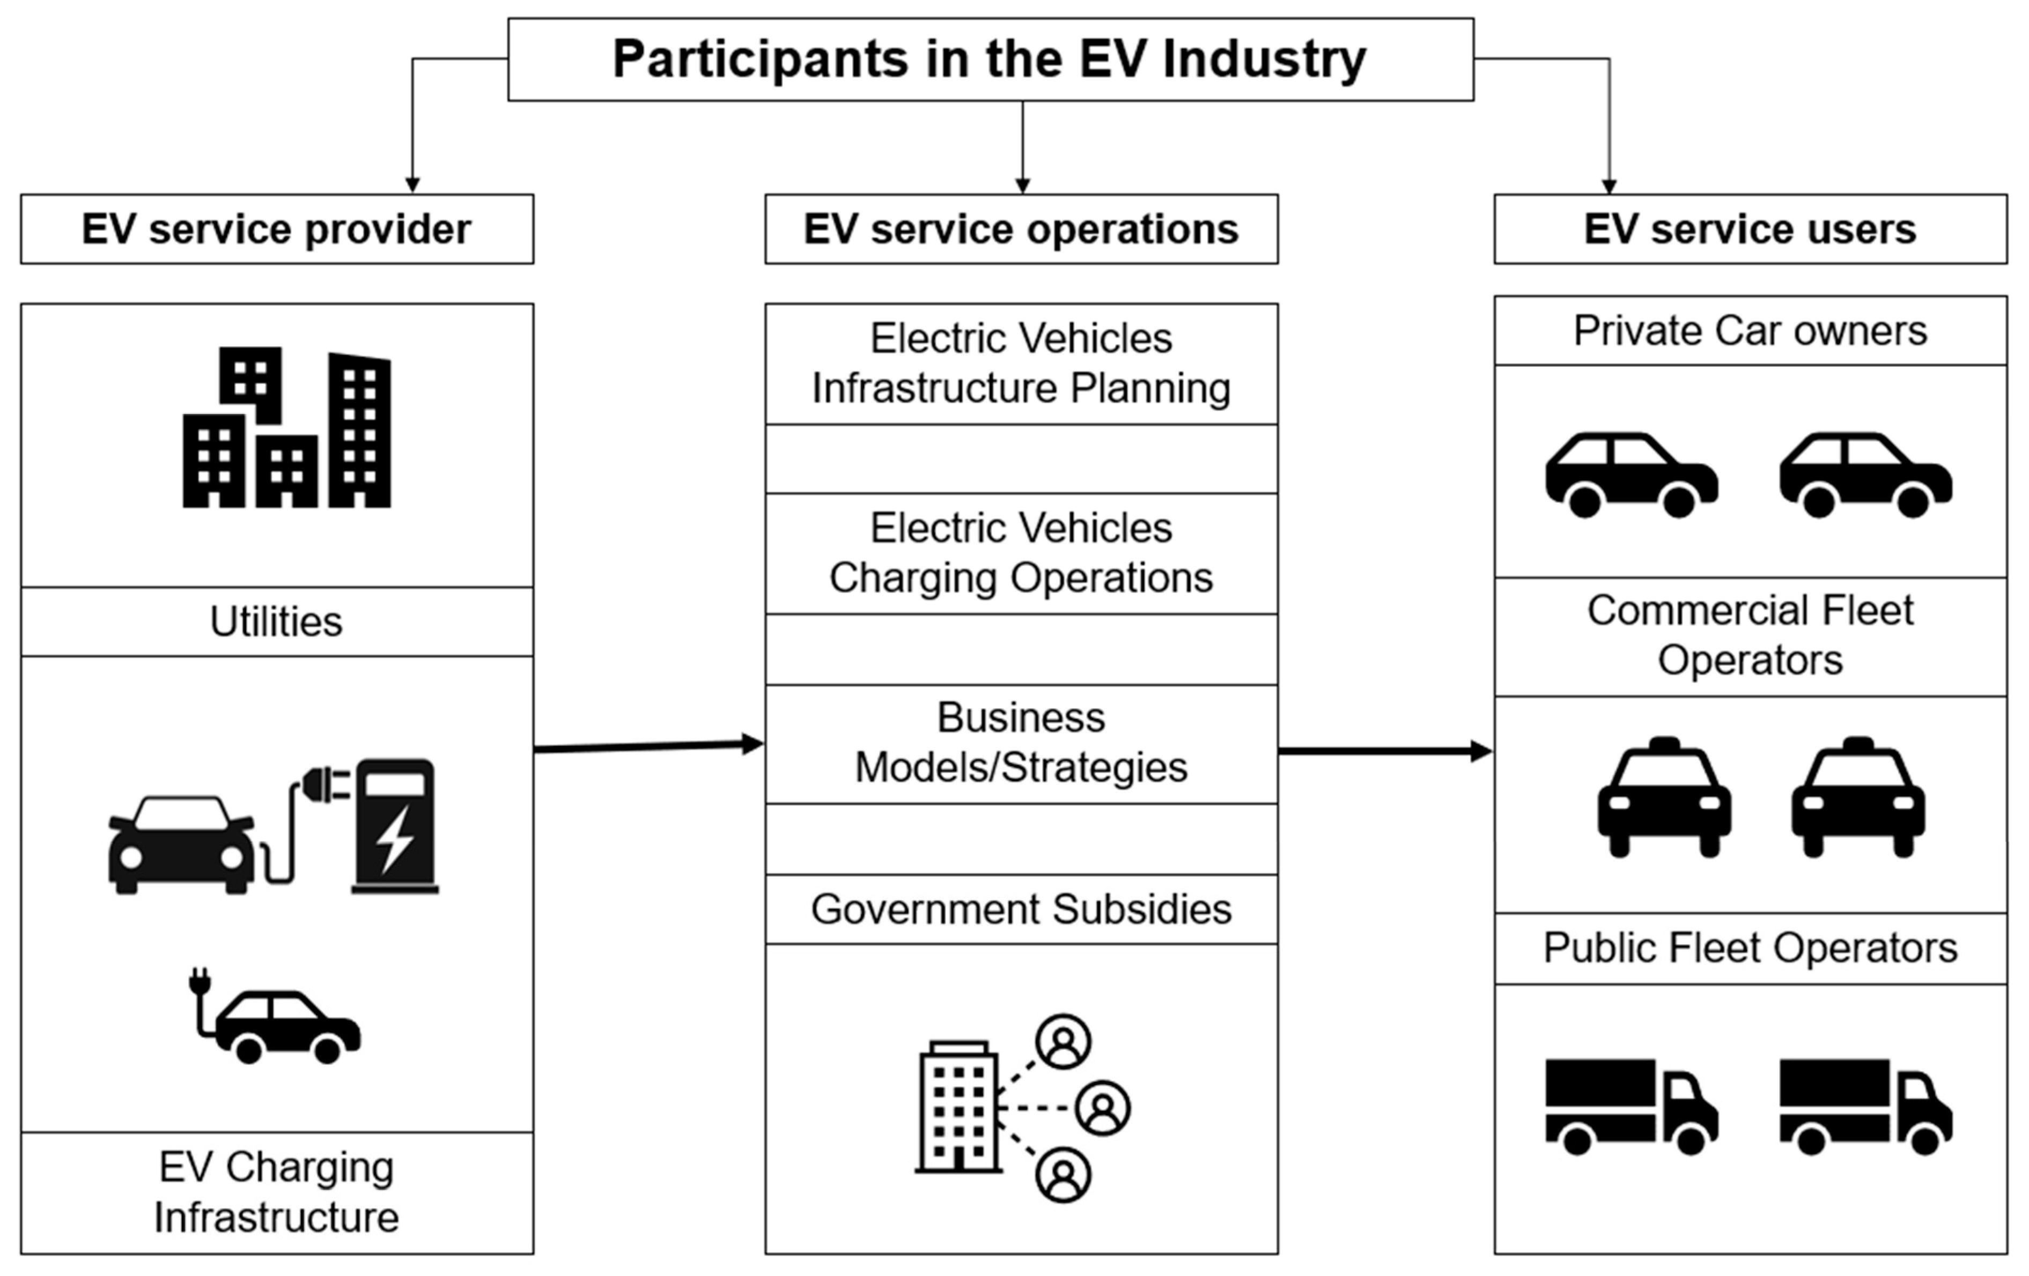
Proposed Solution
To overcome these challenges, potential solutions include enhancing the charging infrastructure, increasing the number of charging stations, using battery swapping techniques, and improving battery technology to address range anxiety and reduce charging times.

Slide 5
System Approach
A Systems Approach provides the foundational knowledge technicians need to safely service all types of electric vehicles (EVs). With a strong emphasis on high-voltage safety, this textbook navigates the complexities of high-voltage drive trains using an easy-to-understand, approachable writing style and engaging visuals. Using real-world examples and illustrations, the text provides an understanding of ICE-hybrid, battery-electric, and fuel cell operation. Coverage includes CAN Bus Communication Systems and telematics in the context of electric vehicles. It incorporates all forms of electric vehicle transportation, including passenger vehicles, construction vehicles, and commercial vehicles. Author Sean Bennett addresses electric vehicles from a technician's perspective, providing them with a strong background in EV technology and giving them an incredible opportunity for rapid advancement in the automobile repair industry.
Focuses on safety, including general service facility safety, high-voltage electricity safety, specialty tools, circuit isolation, and first responder practices
Includes an overview of high-voltage drive train topology and powertrain schematics that illustrate the power flow of typical BEVs, HEVs, PHEVs, and FCEVs
Examines electric vehicle battery chemistry, electric motor technology, EV power electronics, and energy storage management

Slide 6
Algorithm & Deployment
The algorithm initializes by computing a modified traveling cost matrix for each EV to consider the charging limitation of EVs. Subsequently, a linear programming (LP) relaxation of an assignment problem is solved to assign the targets to the EVs.

Slide 7
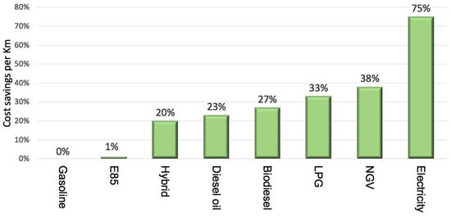
Result
Eco-friendly cars consume little to no fuel and are non-polluting for the environment. Being battery-powered, they do not emit harmful pollutants into the atmosphere. These vehicles must also be compliant with EURO-6 emission norms.

Slide 8
Conclusion
Electric vehicles (EVs) are a promising technology for achieving a sustainable transport sector in the future, due to their very low to zero-carbon emissions, low noise, and high efficiency. Nonetheless, the large penetration of EVs is expected to affect the existing power grids, due to high loads.

Slide 9
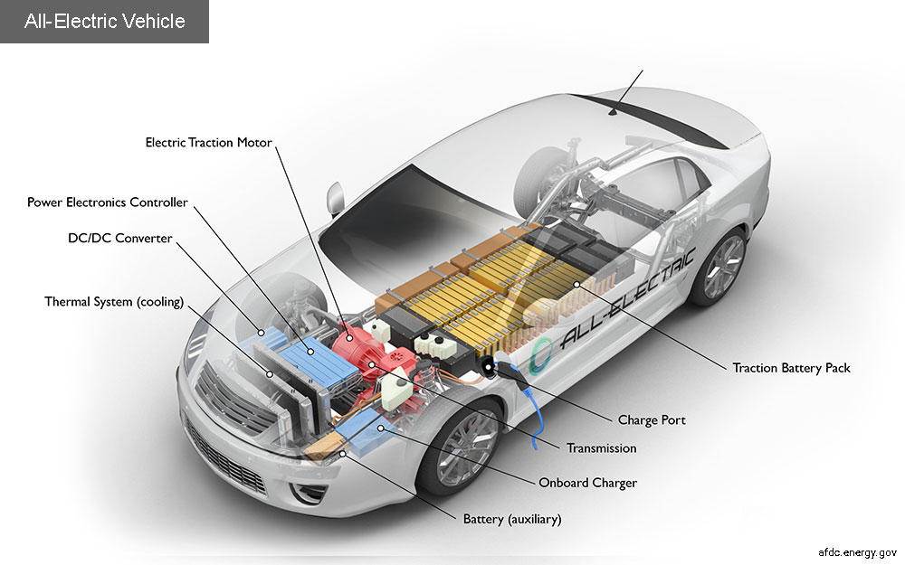
Future scope
For instance, a recent survey shows that between 2021 and 2022, the number of EVs sold in India jumped by a whopping 210 percent. Likewise, according to the Economic Survey of 2023, the country's yearly sale of electric vehicles will touch the 10 million threshold by 2030.

Slide 10
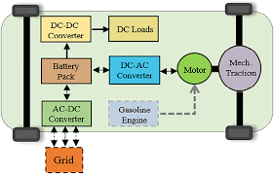
References
ELECTRIC CAR INSIDER. 1. ELECTRIC VEHICLE BASICS. Electric Vehicle Reference. ESSENTIAL CONCEPTS. 2. ELECTRIC CAR INSIDER. 3. Contents. Range, Refueling ..

Slide 11
THANK YOU

